Slide 1
.NET Core 3 Migrating a sample WPF App to .NET Core 3
https://devblogs.microsoft.com/dotnet/migrating-a-sample-wpf-app-to-net-core-3-part-1/
https://devblogs.microsoft.com/dotnet/migrating-a-sample-wpf-app-to-net-core-3-part-2/

Slide 2
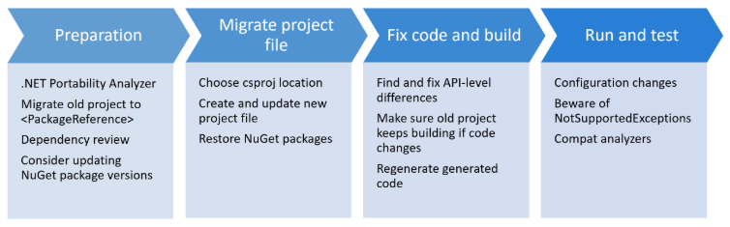
.NET Core 3 Migrating a sample WPF App to .NET Core 3
4 Major Steps

Slide 3
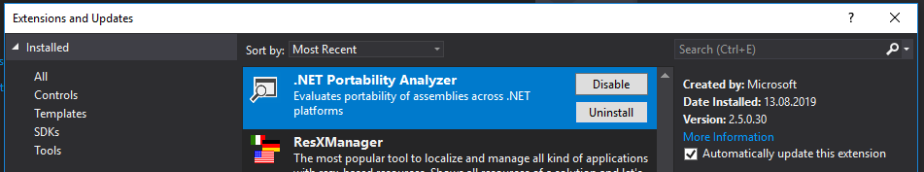
.NET Core 3 Migrating a sample WPF App to .NET Core 3
Preparation
.NET Portability Analyzer
Visual Studio 2017 Extension

Slide 4
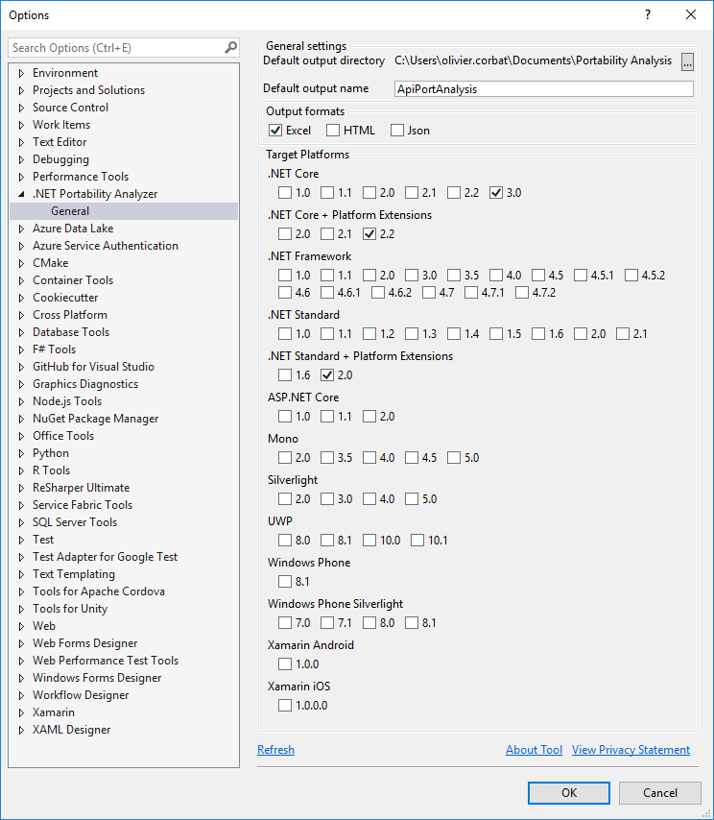
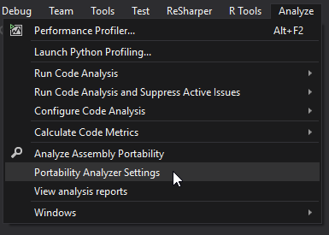
.NET Core 3 Migrating a sample WPF App to .NET Core 3

Slide 5
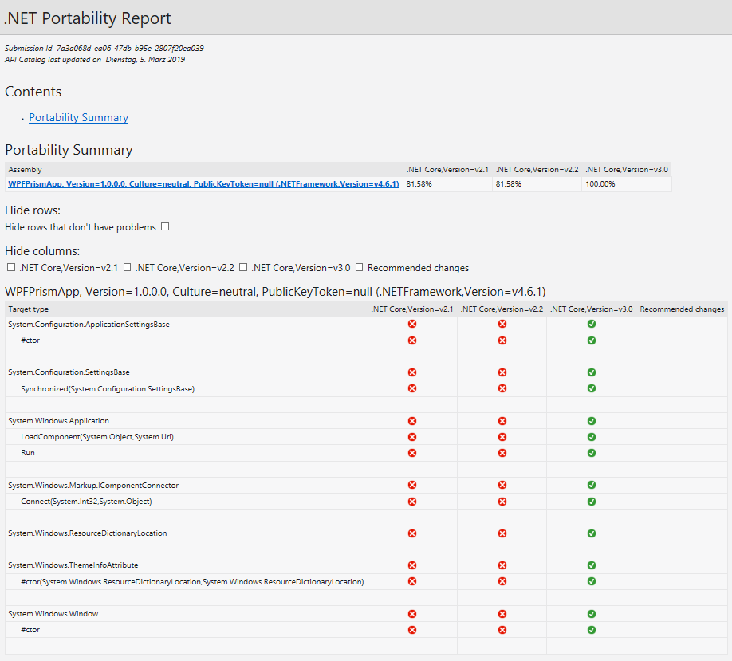
.NET Core 3 Migrating a sample WPF App to .NET Core 3
.NET Portability Report

Slide 6
.NET Core 3 Migrating a sample WPF App to .NET Core 3

Slide 7
.NET Core 3 Migrating a sample WPF App to .NET Core 3
Migrate Project File

Slide 8
.NET Core 3 Migrating a sample WPF App to .NET Core 3
Fix Code and Build

Slide 9
.NET Core 3 Migrating a sample WPF App to .NET Core 3
Run Code and Test

